Slide 1

Accessible public service request Platform
Under Guidance of – Ravi Teja Sir

Slide 2

Presented by
1 | Prajwal patil
2 | Rishabh Umredkar
3 | Pratiksha Wadgure
4 | Khushbu
5 | Sneha bamandi

Slide 3

INTRODUCTION
An accessible public service request platform is a digital tool or website that allows citizens to easily request services or report issues to government or public service organizations. These platforms are designed to be user-friendly and inclusive, ensuring that people of all abilities can navigate and use the service effectively.

Slide 4
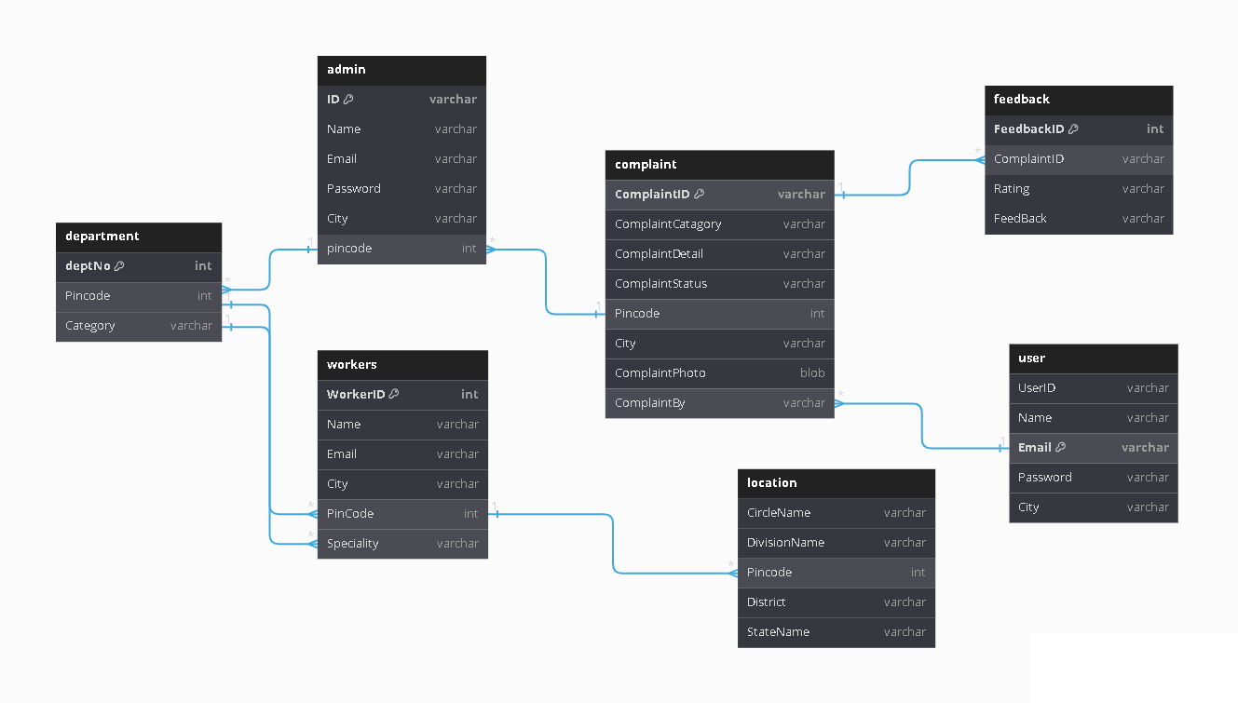
Database Diagram

Slide 5
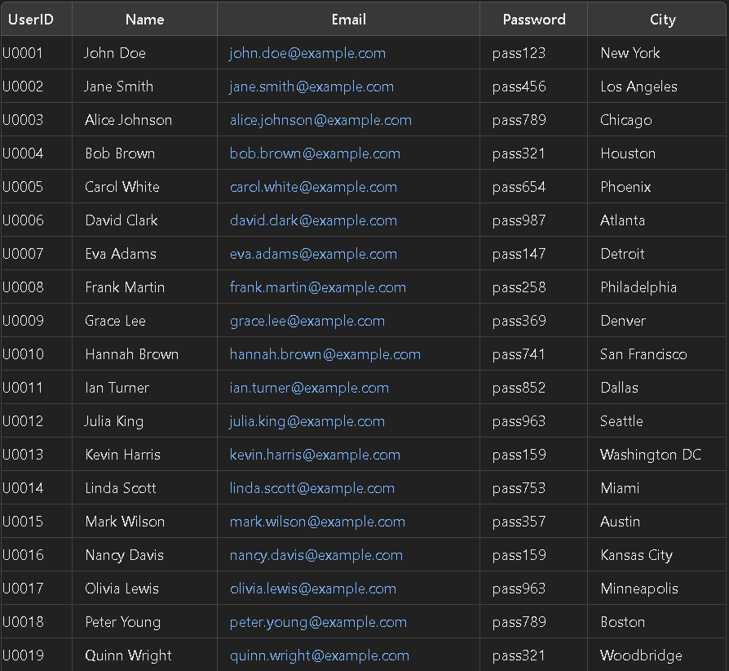
User table
CREATE TABLE "user" (
UserID CHAR(10) NOT NULL,
Name VARCHAR2(45) DEFAULT NULL,
Email VARCHAR2(45) NOT NULL,
Password VARCHAR2(45) NOT NULL,
City VARCHAR2(20) NOT NULL,
CONSTRAINT user_pk PRIMARY KEY (Email)
);

Slide 6
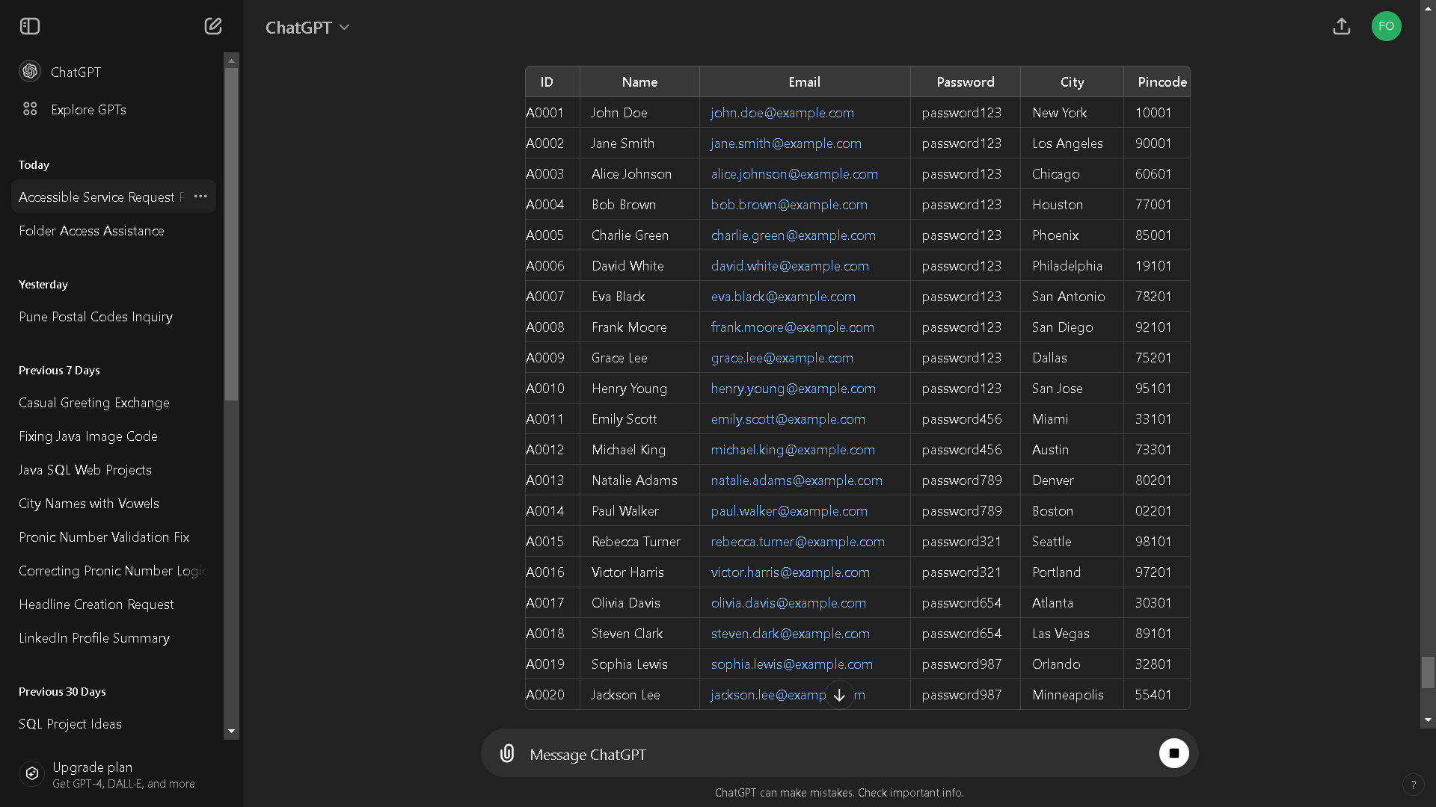
Admin Table
CREATE TABLE admin (
ID CHAR(10) NOT NULL,
Name VARCHAR2(45) NOT NULL,
Email VARCHAR2(45) NOT NULL,
Password VARCHAR2(45) NOT NULL,
City VARCHAR2(45) NOT NULL,
Pincode NUMBER(10) NOT NULL,
CONSTRAINT admin_pk PRIMARY KEY (ID)
);

Slide 7
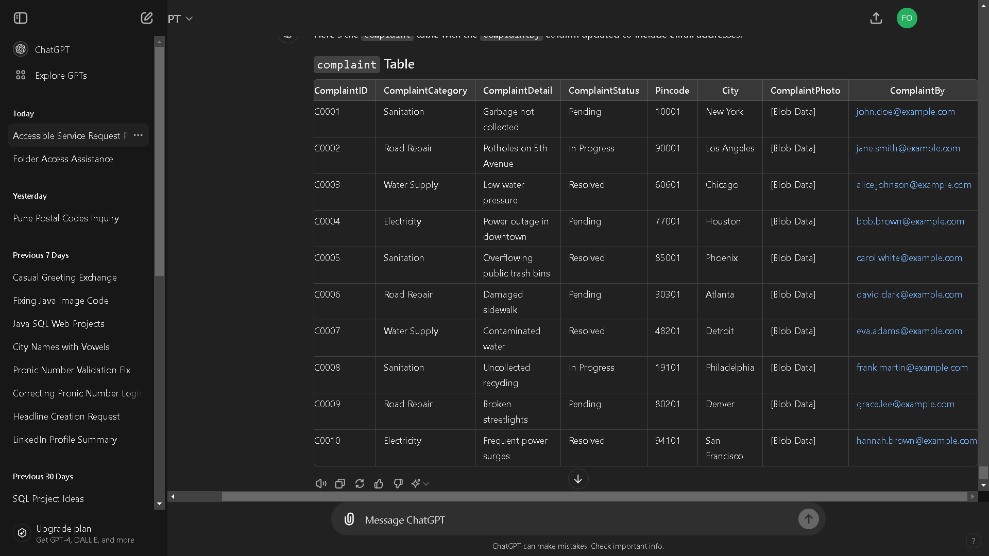
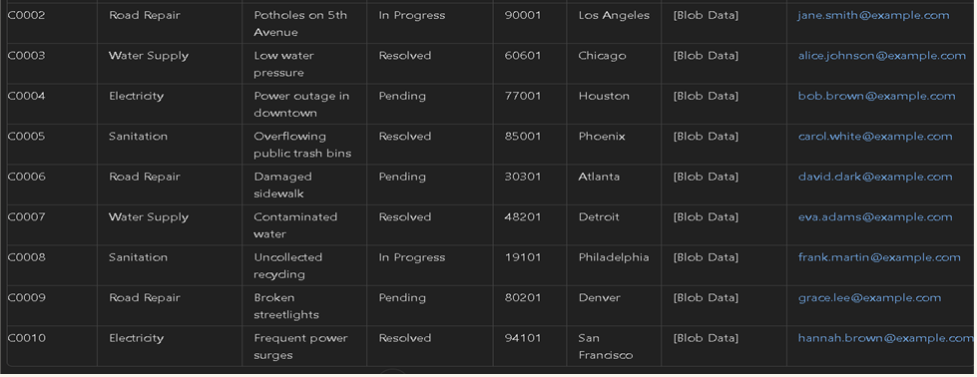
Complaint Table
CREATE TABLE complaint (
ComplaintID CHAR(10) NOT NULL; ComplaintCategory VARCHAR2(20) NOT NULL,
ComplaintDetail VARCHAR2(200) NOT NULL,
ComplaintStatus VARCHAR2(200) DEFAULT 'Pending' NOT NULL,
Pincode NUMBER(10) NOT NULL, City VARCHAR2(45) NOT NULL,
ComplaintPhoto BLOB NOT NULL,
ComplaintBy VARCHAR2(25) NOT NULL,
CONSTRAINT complaint_pk PRIMARY KEY (ComplaintID)
);

Slide 8
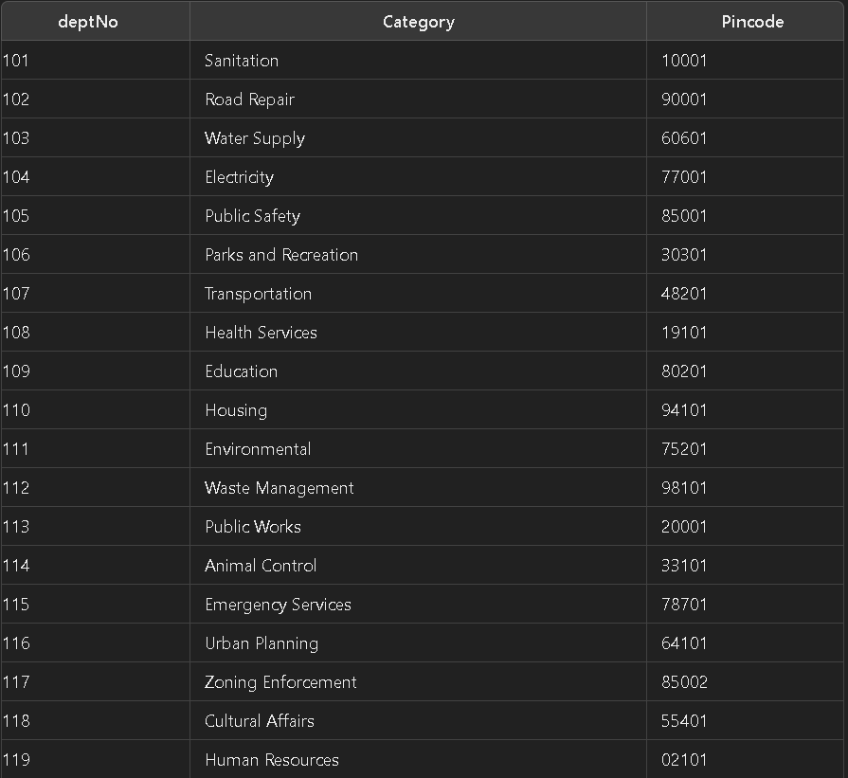
Department table
CREATE TABLE department (
deptNo NUMBER(10) NOT NULL,
Piincode NUMBER(6) NOT NULL,
Category VARCHAR2(45) NOT NULL,
CONSTRAINT department_pk PRIMARY KEY (deptNo)
);

Slide 9
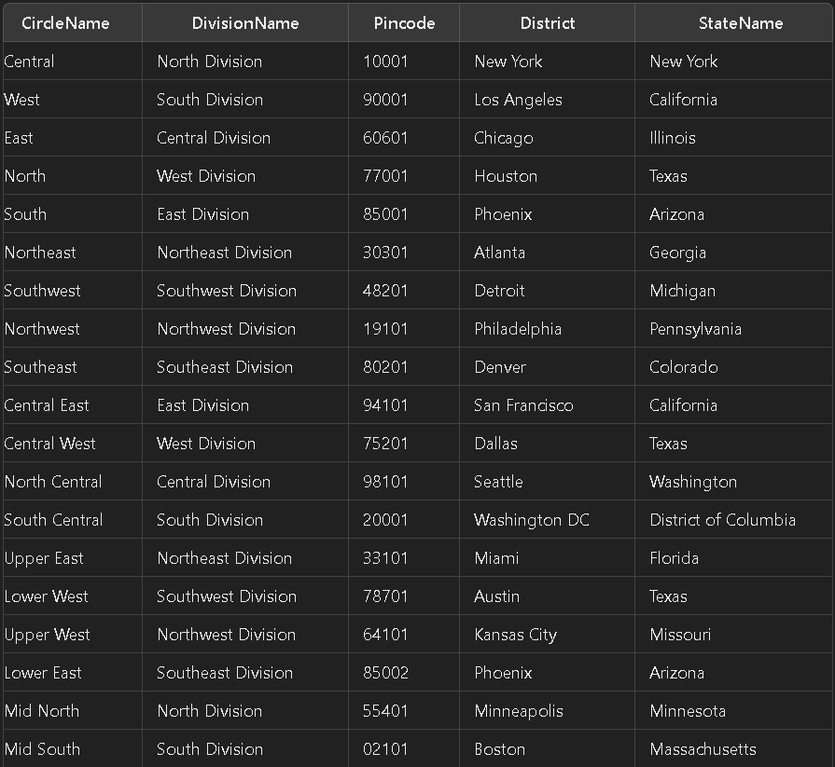
location Table
CREATE TABLE location (
CircleName VARCHAR2(512) DEFAULT NULL,
DivisionName VARCHAR2(512) DEFAULT NULL,
Pincode NUMBER(11) DEFAULT NULL,
District VARCHAR2(512) DEFAULT NULL,
StateName VARCHAR2(512) DEFAULT NULL
);

Slide 10
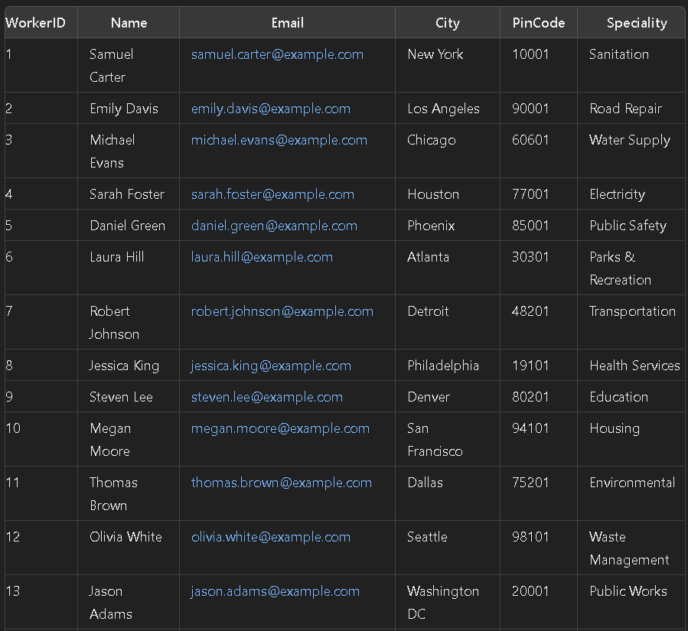
Workers Table
CREATE TABLE workers (
WorkerID NUMBER(10) NOT NULL,
Name VARCHAR2(45) NOT NULL,
Email VARCHAR2(45) NOT NULL,
City VARCHAR2(45) NOT NULL,
PinCode VARCHAR2(45) NOT NULL,
Speciality VARCHAR2(45) NOT NULL,
CONSTRAINT workers_pk PRIMARY KEY (WorkerID),
CONSTRAINT workers_speciality_fk FOREIGN KEY (Speciality) REFERENCES department (Category)
);

Slide 11
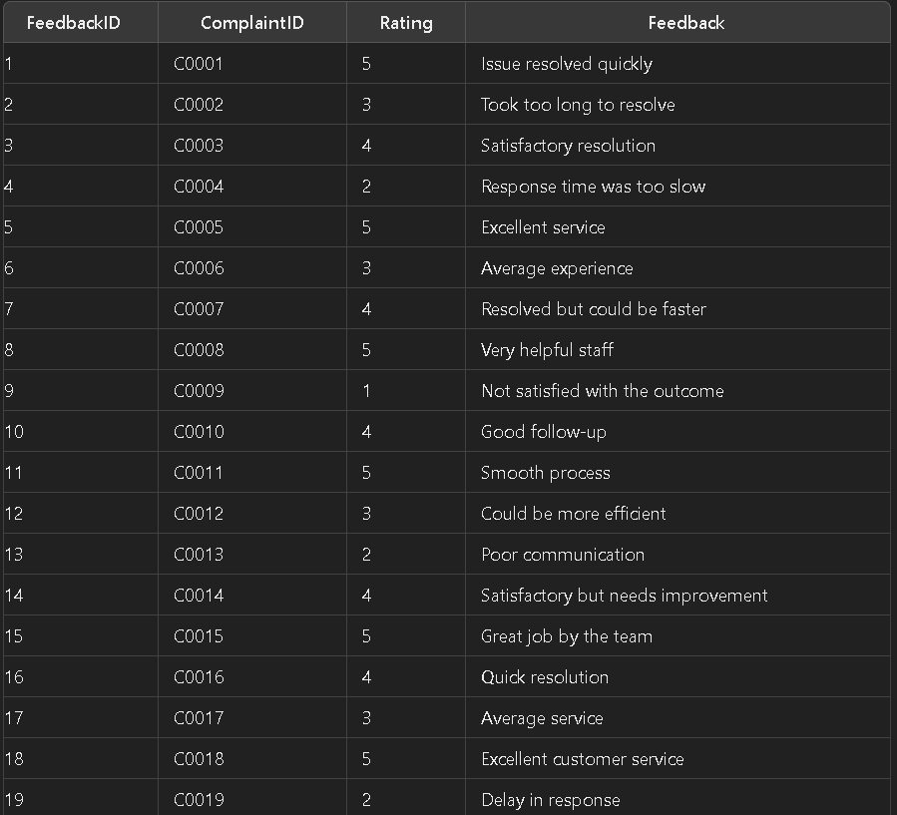
Feedback table
CREATE TABLE feedback (
FeedbackID NUMBER(10) NOT NULL,
ComplaintID CHAR(10) NOT NULL,
Rating VARCHAR2(45) NOT NULL,
FeedBack VARCHAR2(45) NOT NULL,
CONSTRAINT feedback_pk PRIMARY KEY (FeedbackID)
);

Slide 12





progress
user
complaint
admin
dept
worker
User will assign a complaint
The complaint will go to the admin
Admin will send complaint to department
Department will send worker to the location
After the work is done worker ask user for the feedback
feedback

Slide 13

Business opportunities are like buses. There's always another one coming.
quote by richard branson

Slide 14



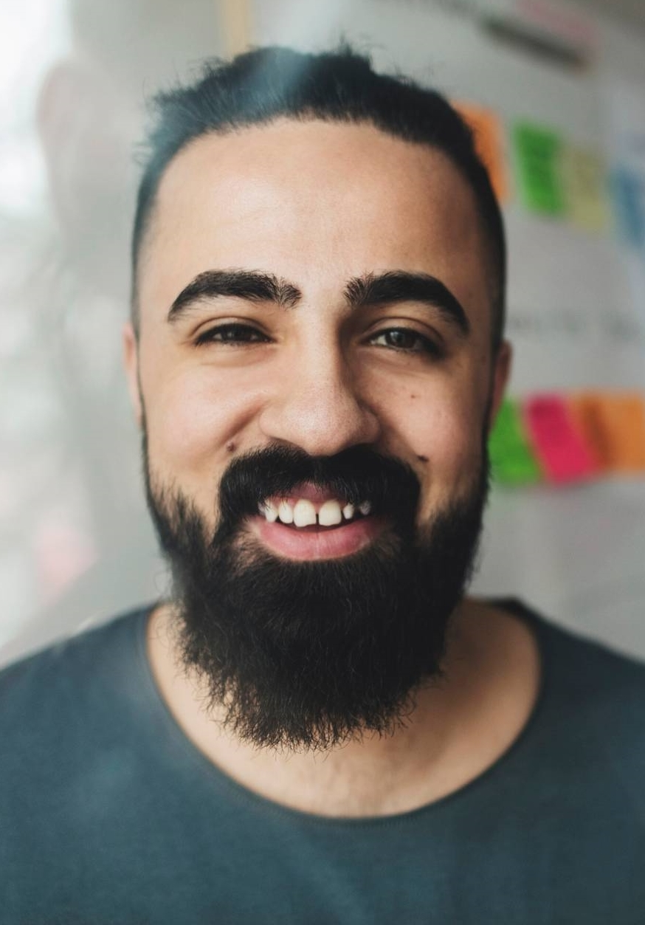
OUR TEAM
Takuma Hayashi​​
Mirjam Nilsson
Flora
Berggren
Rajesh Santoshi
president
chief operations officer
chief executive officer
vp marketing

Slide 15








OUR Extended TEAM
Takuma Hayashi​​
Mirjam Nilsson
Flora Berggren
Rajesh Santoshi
president
chief operations officer
chief executive officer
vp marketing
Graham barnes
rowan murphy
ELIZAbeth moore
robin kline
vp product
seo strategist
product designer
content developer

Slide 16

PLANS FOR PRODUCT LAUNCH
MARKETING
STRATEGY
Disseminate standardized metrics
Foster holistically superior methodologies
2
4
DESIGN
LAUNCH
Coordinate e-business applications
Deploy strategic networks with compelling e-business needs
1
PLANNING
Synergize scalable e-commerce
3
5

Slide 17

AREAS OF FOCUS
b2b market scenarios
Develop winning strategies to keep ahead of the competition
Capitalize on low-hanging fruit to identify a ballpark value
Visualize customer directed convergence
cloud-based opportunities
Iterative approaches to corporate strategy
Establish a management framework from the inside

Slide 18
HOW WE GET THERE
Envision multimedia-based expertise and cross-media growth strategies
Visualize quality intellectual capital
Engage worldwide methodologies with web-enabled technologies
ROI
Pursue scalable customer service through sustainable strategies
Engage top-line web services with cutting-edge deliverables
NICHE MARKETS
Cultivate one-to-one customer service with robust ideas
Maximize timely deliverables for real-time schemas
SUPPLY CHAINS

Slide 19
SUMMARY
At Contoso, we believe in giving 110%. By using our next-generation data architecture, we help organizations virtually manage agile workflows. We thrive because of our market knowledge and great team behind our product. As our CEO says, "Efficiencies will come from proactively transforming how we do business."

Slide 20

THANK YOU
MIRJAM NILSSON
mirjam@contoso.com
www.contoso.com

